Slide 1




PROJECT
PRESENTATION
HANDWRITTEN DIGIT PREDICTION
GROUP -3

Slide 2
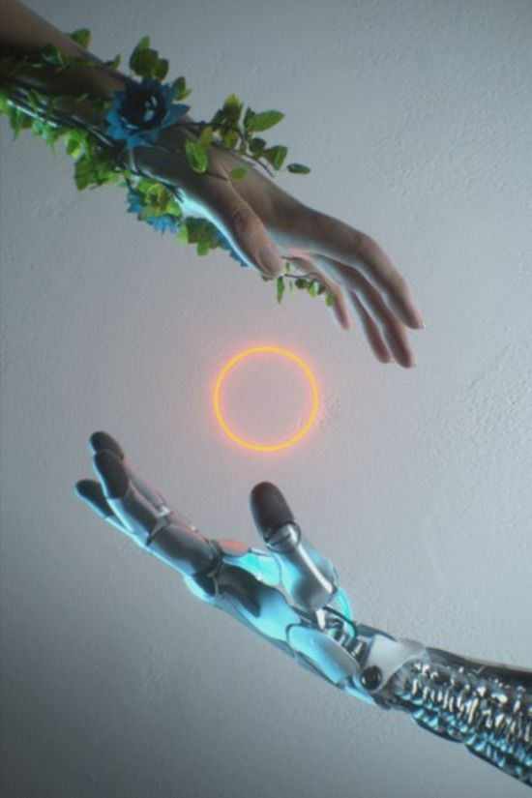

TEAM MEMBERS
Sai keerthan
Chaithra M
computer science engineering
3rd year
SRM UNIVERSITY AP
computer science and engineering
3rd year
Mysore College of Engineering and Management.
Digambar Dhanagar
Jyothika sujith
Atlassian Engineer
Company: Padah Solutions pvt LTD.
computer science engineering
3rd year
Mahendra Engineering College

Slide 3

CONTENT
01
02
03
04
05
Abstract
Introduction
About the dataset
Methodology
Model Architecture
06
07
08
09
10
Data preprocessing
Comparative analysis
Results
User interface
Conclusion

Slide 4


ABSTRACT
✓ This project presents a comparative analysis of three neural network models—LeNet-5,a Multi-Layer Perceptron (MLP),a Convolutional Neural Network (CNN) and ResNet-50 with data augmentation—trained on the MNIST dataset for handwritten digit recognition.
✓ Additionally, a user interface was developed using Flask to facilitate the prediction of handwritten digits using these models.
✓ The study highlights the architectural differences, training methodologies, resulting accuracies, and the user interface design for the models.
✓ The results indicate that the basic CNN with data augmentation achieves the highest accuracy, demonstrating the effectiveness of data augmentation in improving model performance.

Slide 5

INTRODUCTION
✓ The MNIST dataset is a widely used benchmark in machine learning, particularly for image classification tasks.
✓ This project aims to compare the performance of three different neural network architectures for classifying handwritten digits from the MNIST dataset.
✓ Furthermore, a user interface was developed to allow users to upload images of handwritten digits and receive predictions from the trained models

Slide 6
ABOUT THE DATASET
✓ The MNIST dataset comprises 70,000 grayscale images of handwritten digits, with 60,000 images in the training set and 10,000 images in the test set.
✓ Each image is 28x28 pixels, normalized and centered, representing the digits 0 through 9.
✓ The dataset's simplicity and balanced class distribution make it ideal for benchmarking machine learning algorithms.

Slide 7



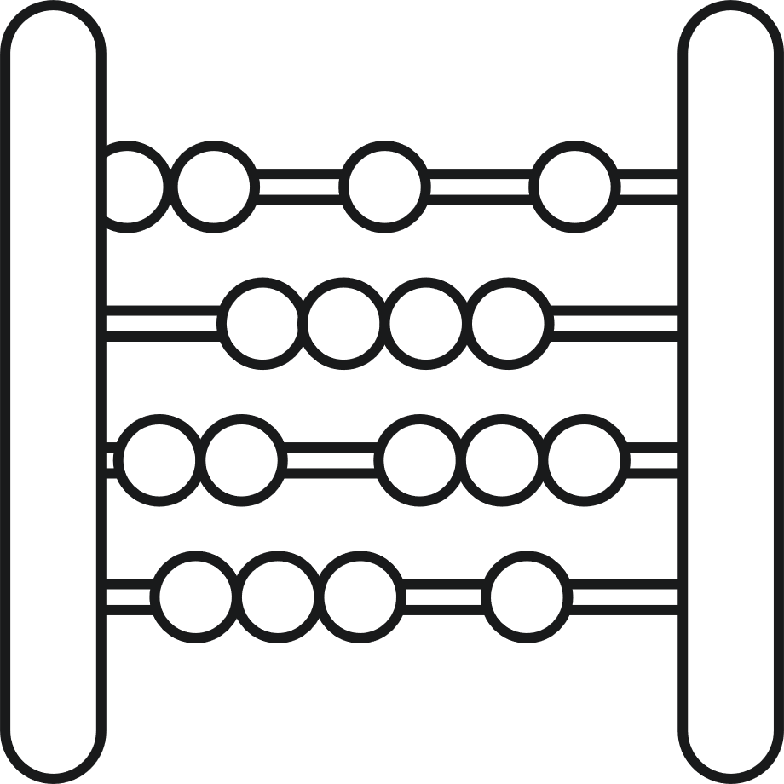



Total Samples
70,000 images
Training Set
60,000 images
Number of Classes
10 (digits 0 through 9)
Test Set
10,000 images
Image Type
Image Size
Grayscale
28x28 pixels

Slide 8



DATA PREPROCESSING
Normalisation
Pixel values scaled to [0, 1].
Reshaping
For MLP, images flattened into 784-dimensional vectors; for CNNs, images reshaped to 28x28x1 arrays.
One hot encoding
Labels converted into one-hot encoded vectors.

Slide 9




MLP
Architecture
Traning
A Multi-layer perceptron with two dense layers, each followed by a dropout layer, and a SoftMax output layer..
Parameters
Adam optimizer, sparse categorical cross-entropy loss, batch size of 128.
669,706

Slide 10
CNN WITH DATA AUGMENTATION
Architecture
Traning
Convolutional neural network with two convolutional layers, max pooling, dropout layers, dense layers, and a SoftMax output layer. Data augmentation techniques such as random rotations, shifts, shear, and zoom were applied.
Parameters
Adam optimizer, sparse categorical cross-entropy loss batch size of 128.
62,006

Slide 11
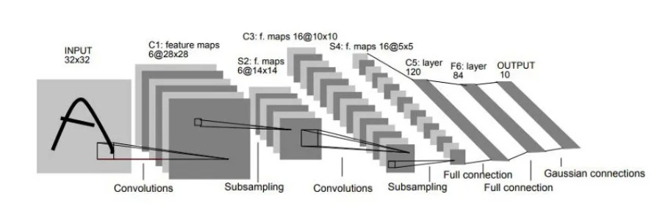
LENET-5
Architecture
Traning
Convolutional neural network with two convolutional layers, average pooling layers, fully connected layers, and a softmax output layer.
Parameters
Adam optimizer, sparse categorical cross-entropy batch size of 128.
61,706

Slide 12
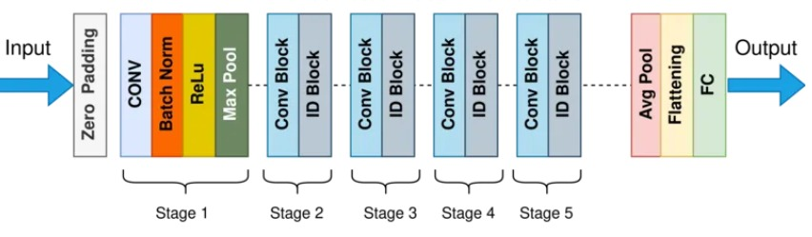
RESNET-50
ResNet50 is a deep convolutional neural network (CNN) architecture that was developed by Microsoft Research in 2015. It is a variant of the popular ResNet architecture, which stands for “Residual Network.” The “50” in the name refers to the number of layers in the network, which is 50 layers deep.
.

Slide 13
COMPARATIVE ANALYSIS
Model | Training Accuracy | Test Accuracy | Parameters
LeNet-5 | ~99.2 | ~98.9 | 61,706
MLP | ~98.5 | ~98.0 | 6,69,706
CNN + Aug | ~99.6 | ~99.4 | 62,006
ResNet-50 | ~97.51 | ~46.15 | --

Slide 14

Poor performance of ResNet-50
The poor performance of ResNet-50 on the MNIST dataset is primarily due to the model's excessive complexity relative to the simplicity of the MNIST images. ResNet-50, designed for high-resolution, three-channel images like those in the ImageNet dataset, is prone to overfitting when trained on the smaller, low-resolution, single-channel MNIST digits. Additionally, the preprocessing steps—resizing and duplicating channels—may introduce artifacts that further degrade performance. The model's large number of parameters leads to memorizing training data rather than learning generalizable features, resulting in poor test accuracy. Fine-tuning fewer layers and using a less complex model could improve results.

Slide 15

LeNet-5
Basic MLP
CNN with Data Augmentation
High accuracy with relatively few parameters, but lacks data augmentation for improved generalization.
Good accuracy but requires significantly more parameters, making it less efficient.
Highest accuracy with efficient parameter usage, demonstrating the benefits of data augmentation.

Slide 16


USER INTERFACE
A Flask-based web application was developed to provide a user-friendly interface for uploading images and receiving predictions from the trained models.

Slide 17
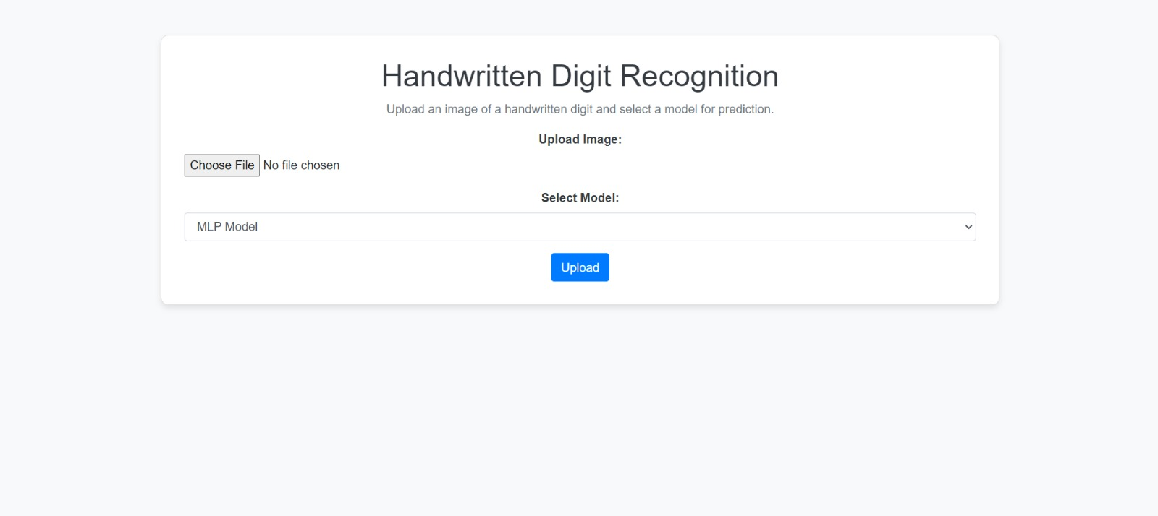

Slide 18
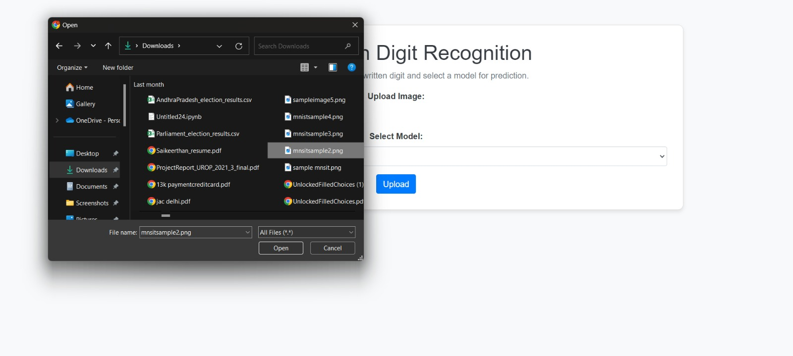

Slide 19
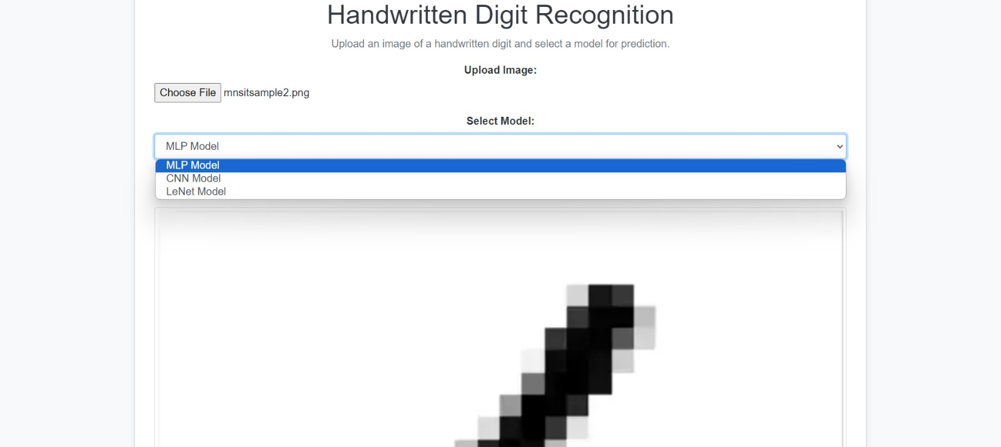

Slide 20
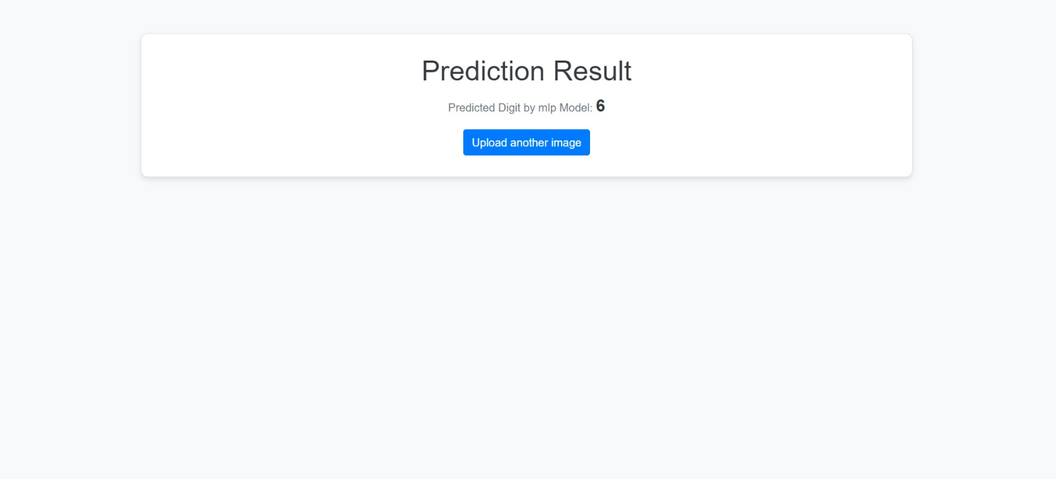

Slide 21
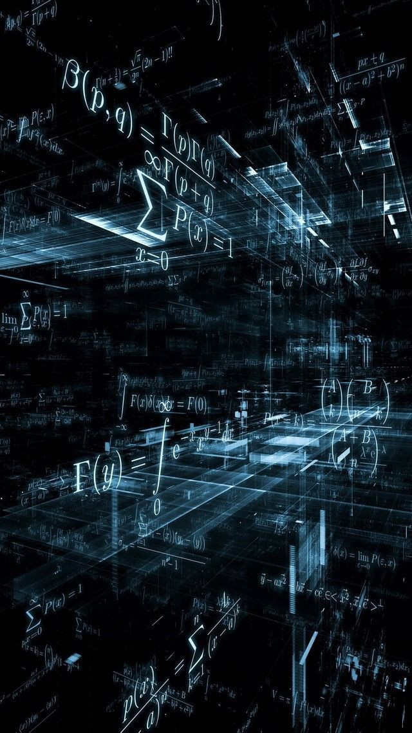
CONCLUSION
✓ The study shows that the basic CNN with data augmentation outperforms both LeNet-5 and the basic MLP in terms of training and validation accuracy.
✓ Data augmentation significantly enhances the model's ability to generalize to new data, resulting in superior performance.
✓ The LeNet-5 model provides a good balance between accuracy and computational efficiency, while the basic MLP, despite achieving high accuracy, is less efficient due to its larger number of parameters.

